Slide 1
School of Computer & Information Sciences
ITS-631- Operational Excellence
Chapter 12 – Information Technology and Organizational Learning
Notes:
Content from:
Primary Textbook: Jamsa, K. A. (2013). Cloud computing: SaaS, PaaS, IaaS, virtualization, business models, mobile, security and more. Burlington, MA: Jones & Bartlett Learning.
Secondary Textbook: Erl, T., Mahmood, Z., & Puttini, R. (2014). Cloud computing: concepts, technology, & architecture. Upper Saddle River, NJ: Prentice Hall.

Slide 2
Introduction
Toward Best Practices
Best practices are defined as generally accepted ways of doing specific functions or processes by a particular profession or industry
Best practices, in the context of ROD, are a set of processes, behaviors, and organizational structures that tend to provide successful foundations to implement and sustain organizational learning

Slide 3
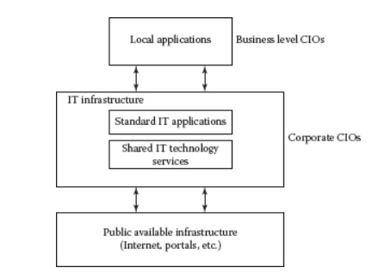
Chief IT Executive
CIO
CTO
CKO
It’s necessary to understand the current information and stats about what each person/role does and how they do it.

Slide 4
Best Practices Chief IT should focus on…
Strategic thinking
Industry expertise
Create and manage change
Communications
Relationship building
Business knowledge
Technology proficiency
Leadership
Management skills
Hiring and retention

Slide 5
Maturity Stages and Dimension Variables
Maturity Stages:
Technology competence and recognition
Multiplicity of technology perspectives
Comprehension of technology process
Stable technology integration
Technology leadership
Performance Dimensions
Technology cognition
Organizational culture
Management values
Business ethics
Executive presence

Slide 6
CEO functions
There was an 85% increase in the number of CIOs who reported directly to the CEO. This increase would suggest that CEOs need to directly manage the CIO function because of its importance to business strategy.
CEOs supporting outsourcing did not receive the cost-cutting results they had hoped for. In fact, most broke even.
CEOs have found that IT organizations that have centralized operations save more money, have fewer help-line calls than decentralized organizations, and do not sacrifice service quality.
CEOs are increasingly depending on the CIO for advice on business improvements using technology. As a result, their view is that IT professionals need advanced business degrees.
CEOs should know that consistent use of IT standards has enabled firms to trim IT development costs by 41%, which has reduced costs for end-user support and training operations by 17%.
CEOs need to increase support for risk management. Only 77% of average companies maintained disaster recovery plans.

Slide 7
Definitions of Maturity Stages for the CEO Technology Arc
Maturity Stages
Conceptual knowledge of technology
Multiplicity of business perspectives of technology
Integration of business uses of technology
Implementation of business/technology process
Strategic uses of technology
Performance Dimensions
Technology concepts
Organizational structures
Executive values
Executive ethics
Executive leadership

Slide 8
Middle Management
Technology best practices must be designed to contain the insights and skills for effective management of technology. This must include:
Working with IT personnel
Providing valuable input to the executive management team, including the CEO
Participating and developing a technology strategy within their business units
Effectively managing project resources, including technical staff
Leading innovative groups in their departments
Incorporating technology into new products and services
Developing proactive methods of dealing with changes in technology
Investigating how technology can improve competitive advantage.

Slide 9
Maturity Stages for Middle Managers
Maturity Stages
Technology implementation competence and recognition
Multiplicity of business implementation of technology
Integration of business implementation of technology
Stability of business/technology implementation
Technology project leadership
Performance Dimensions
Business technology cognition
Organizational interactions
Management values
Project ethics
Management presence

Slide 10
Ethics and Maturity
Create an ethical IT organizational model
The technology executive has control over that organization.
Most IT ethical problems today emanate from technology personnel because of their unusual access to data and information.
IT is positioned to lead the direction, since it is its area of expertise.
The code of ethics should focus on:
Privacy
Confidentiality
Moral responsibility
Theft

Slide 11
References
Langer, A. M. (2018). Information Technology and Organizational Learning. 3rd edition. Taylor & Francis Group, LLC. ISBN: 978-1-138-23858-9

