Slide 1
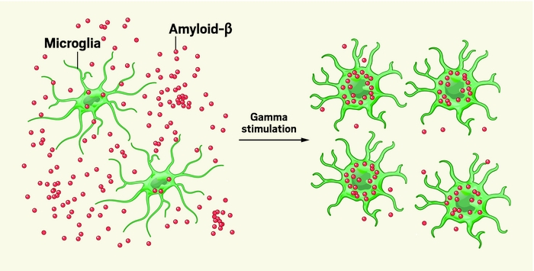
40 Hz Gamma frequency leads to the activation of microglia therefore ameliorates amyloid-β plaque (1)

Slide 2
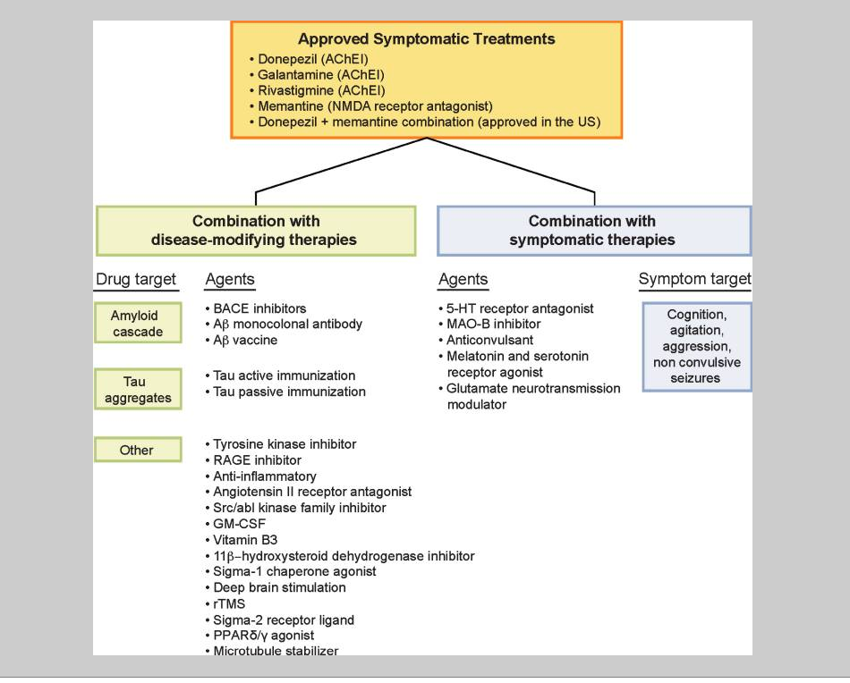
Introduction
Alzheimer's disease
Degenerative brain disease and the most common form of dementia.
Amyloid plaque
There are many treatments that target different aspect of the diseases.
Notes:
Alzheimer's disease is the most prevalent form of dementia

Slide 3
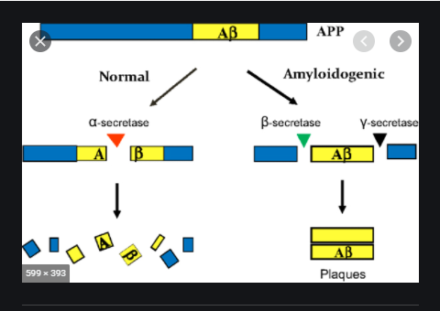
How does the amyloid plaque forms
Hydrolysis of Amyloid Precursor Protein

Slide 4
Microglia
A type of glia cell
Morphological shift
Activated by 40Hz brainwave.
Engulfing Amyloid-B protein

Slide 5
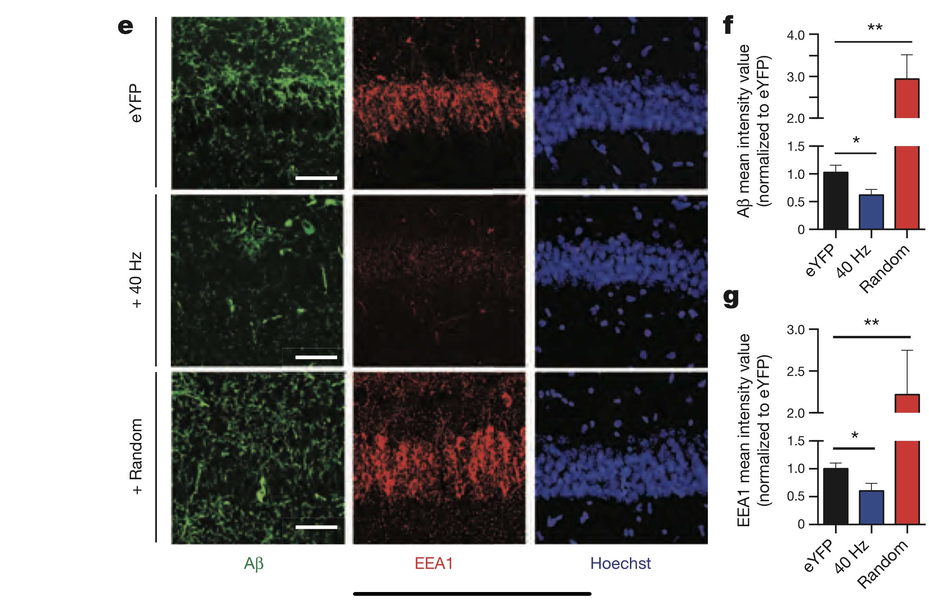
40Hz stimulation
Amyloid-B protein plaques in the
Mouse’s brain decreases compare with
non stimulated mouse.

Slide 6
Previous Morris Water Maze Result
Stimulated 5XFAD mouse took less time than the
other AD mouse.

Slide 7
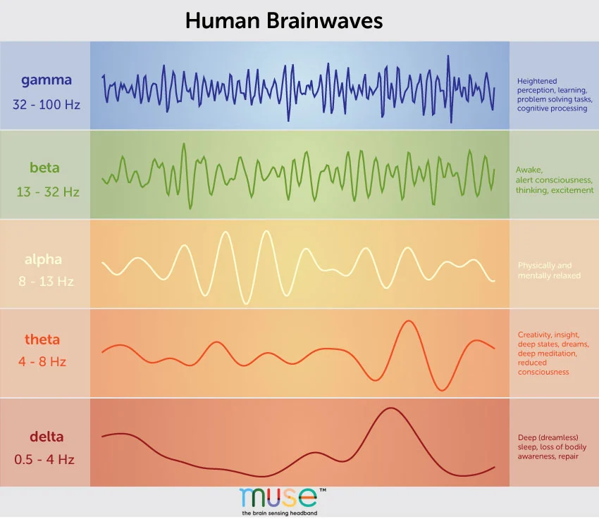
Gamma Frequency
Non-invasive light flicker at 40 Hz
(Gamma ENtrainment Using Sensory stimulus, or GENUS)
In the experiment, Auditory stimulation (4)
20Hz
40Hz
80Hz

Slide 8
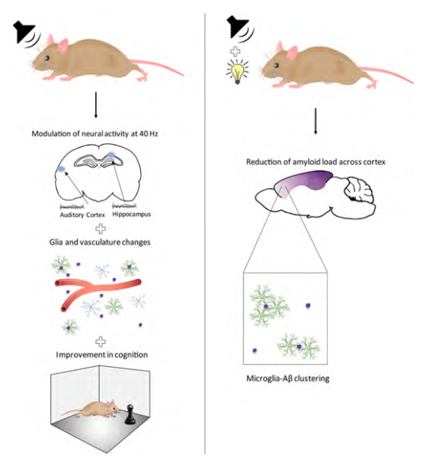
experiment -- activate microglia to ameliorate amyloid plaque
Relative soluble Aβ1–42 levels in AC and HPC in 6-month-old 5XFAD mice following 40 Hz, 8 Hz, 80 Hz, or random auditory stimulation for 1 hr/day for 7 days (1-week)
40 Hz
Random
No Stimulation

Slide 9
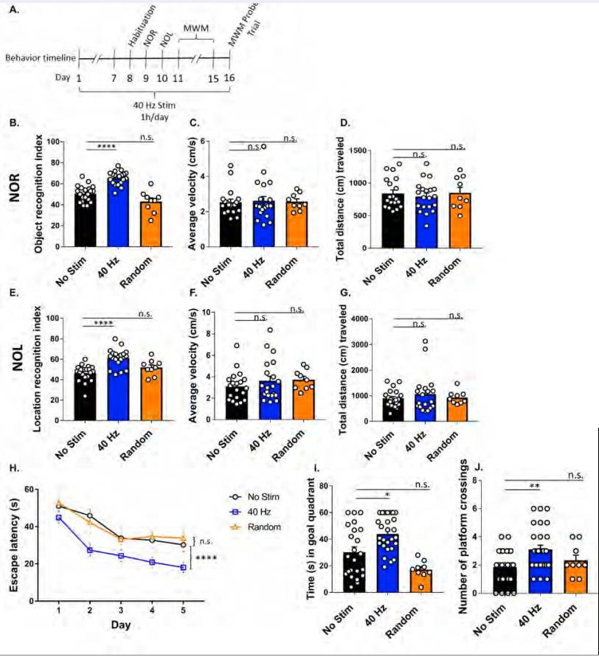
Result of the experiment
It is showing improvement
Behavior experiments
Objection recognition index
Location recognition index
Escape latency

Slide 10
Can it improve cognitive function in AD remains to be determined

Slide 11
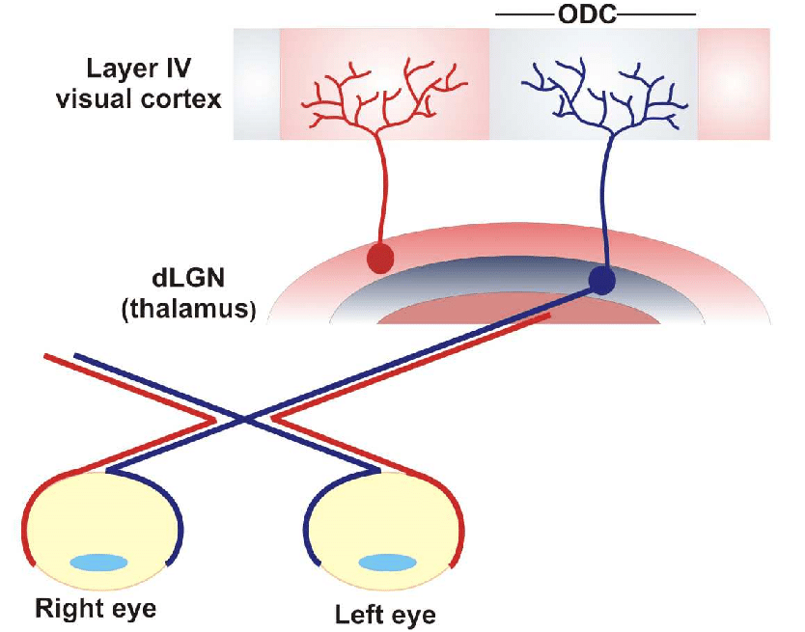
Retinal Ganglion Cells (RGCs)
&
The dorsal lateral geniculate nucleus (dLGN)
Notes:
A retinal ganglion cell (RGC) is a type of neuron located near the inner surface (the ganglion cell layer) of the retina of the eye
Dorsal lateral geniculate nucleus receives a major sensory input from the retina

Slide 12
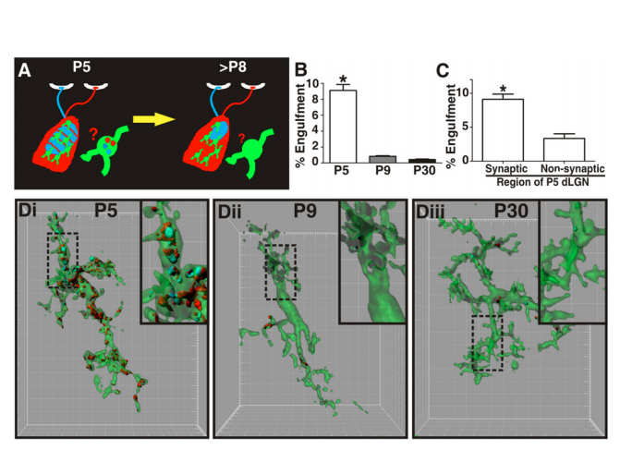
2nd part-- Microglia and the developing synapses
Engulfment of RGC inputs is significantly increased during peak pruning in the dLGN (P5)
Engulfment in P5 dLGN occurs most significantly in synapse-enriched

Slide 13
Dynamic interactions between microglia and synaptic elements in the healthy brain.
microglia engulf presynaptic inputs during peak retinogeniculate pruning and that engulfment is dependent upon neural activity and the microglia-specific phagocytic signaling pathway, complement receptor 3(CR3)/C3. Furthermore, disrupting microglia-specific CR3/C3 signaling resulted in sustained deficits in synaptic connectivity.

Slide 14
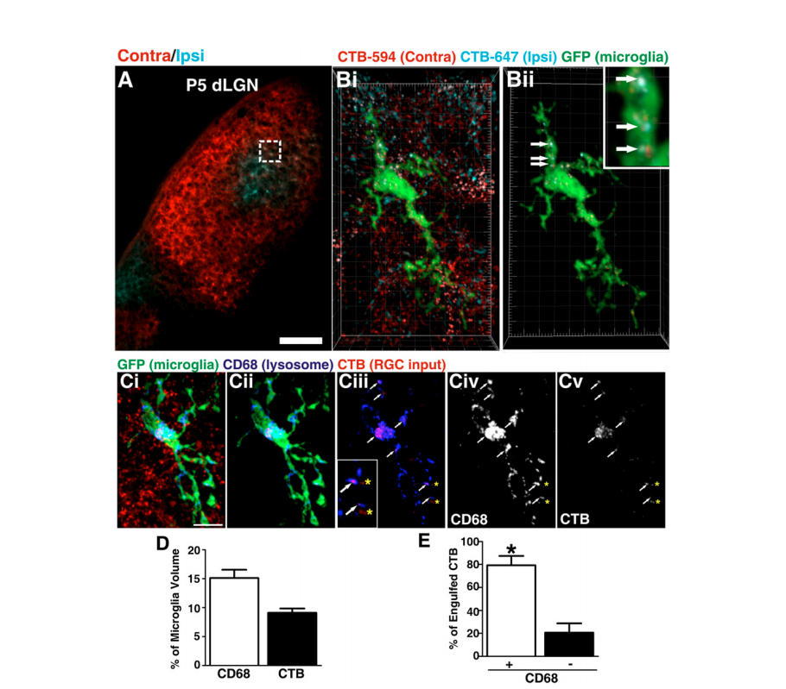
Experiment -- Microglia engulfment
Tools
High resolution confocal imaging
dLGN with intraocular injection if anterograde tracer
Microglia were labeled using the CX3CR1+/GFP mouse line
microglia express EGFP under the control of fractalkine receptor, CX3CR1
Notes:
To confirm that inputs are phagocytosed by microglia, RGC inputs from both eyes were labeled with CTB-594 and colocalization with CD68, a marker of lysosomes specific to microglia, was assessed in P5 dLGN.

Slide 15
Result
Microglia engulf and remodel developing synapses
Underlying mechanism is involved.

Slide 16
Questions
Is microglia going to engulfing developing synapses as well as the plaque?
Since we know microglia have the ability to engulfing Synapses
Contradicting effect ( plaque lost ---synapses lost )
The recorded time span of the data for the 5XFAD mice is only 7 days
But what if the experiment was done for more than 7 days?
Are there going to be disastrous effect after 7 days?
Due to the continuation of microglia activation that will engulf snapses?
The influence of microglia to the long term memory
Is the activation of microglia at 40 Hz dependent on the present of amyloid plaque
Can it distinguish plaque and synapses

Slide 17
Hypothesis
Microglia can have a increase of activity by 40 Hz without the present of Amyloid Plaque.
And it does not obtain the ability to distinguish the Amyloid Plaque from synapses.
Therefore long term effect due to the GENUS can have adversely affect in terms of the neural activity.

Slide 18
Experimental Approach
Increase the time span of the experiment from 7 days to multiple different time span
14 days
28 days
56 days
Same control groups and experimental group regarding GENUS
20 Hz
40 Hz
80 Hz
Method
Water maze
Object recognition index
Location recognition index
Control experiment
One with plaque (5XFAD)
No plaque (healthy)

Slide 19
Summary-Hypothesis, Significance, and Treatment Development
Hypothesis - Microglia, not having the ability to distinguish between Amyloid Plaque and synapses, can have an increase of activity by 40 Hz without the presence of Amyloid Plaque. Therefore long term effect due to the GENUS can have adversely affect in terms of the neural activity.
Significance - If the hypothesis is been proved, it prove that the only using the strategy of GENUS and 40Hz oscillations can’t heal patients’ Alzheimer disease, so it can’t directly develop into a treatment. It will also bring up future questions and directions of investigations on the topic of microglia and how can it be used to cure Alzheimer disease based on the result of this experiment.
Treatment Development - If our hypothesis is proved wrong, that microglia can distinguish between synapse and Amyloid Plaques, do not engulf synapse at the same time when it engulf Amyloid Plaques, and will not cause decrease the memory of patients in long term, then microglia may be employed to clean up the Amyloid Plaques in patients’ brain and use as part of the future treatment.

Slide 20
Summary-Analysis of possible results
If it is proved that after treated by GENUS, the memorizing ability of the 5XFAD rats gets better, then it indicate that GENUS have positive long term effect on neural activity and imply that microglia do not engulf synapse or engulf less synapse when it is engulfing Amyloid Plaques. This will be disagreeing with the thesis on the part that “long term effect due to the GENUS can have adversely affect in terms of the neural activity” and “microglia does not obtain the ability to distinguish the Amyloid Plaque from synapses”.
If it is proved that after treated by GENUS, the memorizing ability of the 5XFAD rats is unchanged or get worse, then it indicate that GENUS have negative long term effect on neural activity and imply that microglia do engulf synapse at the same time when engulfing Amyloid Plaques. This will be agreeing with the hypothesis on the part that “long term effect due to the GENUS can have adversely affect in terms of the neural activity” and “microglia does not obtain the ability to distinguish the Amyloid Plaque from synapses”.

Slide 21
Summary-Analysis of possible results
If we perceived an increase of microglia activity in healthy rats’ brain after giving them 40 Hz oscillations, then it will prove the hypothesis of “Microglia can have an increase of activity by 40 Hz without the presence of Amyloid Plaque”.
If we perceived an unchanged or merely changed microglia activity in healthy rats’ brain after giving them 40 Hz oscillations, then it will disprove the hypothesis of “Microglia can have an increase of activity by 40 Hz without the presence of Amyloid Plaque”.

Slide 22
Summary-Future Questions to Investigate
1. Will there be other side effects of activating and using microglia?
2. Can microglia be activated by other factors?
3. Why can microglia be activated by 40 Hz oscillations?
4. Why do microglia engulf Amyloid Plaques? Are there other things that can do the same thing or have similar function? In other words, can microglia be replaced by other substance?
5. If microglia do engulf synapse at the same time when engulfing Amyloid Plaques, can this problem be solved, or what can we do to modify its activity to allow it to distinguish between synapse and amyloid plaques and only engulf Amyloid Plaques?

Slide 23
Reference page
Iaccarino, H., Singer, A., Martorell, A. et al. Gamma frequency entrainment attenuates amyloid load and modifies microglia. Nature 540, 230–235 (2016). https://doi.org/10.1038/nature20587
Martorell AJ, Paulson AL, Suk HJ, et al. Multi-sensory Gamma Stimulation Ameliorates Alzheimer's-Associated Pathology and Improves Cognition. Cell. 2019;177(2):256-271.e22. doi:10.1016/j.cell.2019.02.014
Oakley H, Cole SL, Logan S, Maus E, Shao P, Craft J, Guillozet-Bongaarts A, Ohno M, Disterhoft J, Van Eldik L, Berry R, Vassar R. Intraneuronal beta-amyloid aggregates, neurodegeneration, and neuron loss in transgenic mice with five familial Alzheimer's disease mutations: potential factors in amyloid plaque formation. J Neurosci. 2006 Oct 4;26(40):10129-40. PubMed.
“A Deep Dive Into Brainwaves: Brainwave Frequencies Explained.” Muse, 8 Nov. 2020, choosemuse.com/blog/a-deep-dive-into-brainwaves-brainwave-frequencies-explained-2/.
Schafer DP, Lehrman EK, Kautzman AG, et al. Microglia sculpt postnatal neural circuits in an activity and complement-dependent manner. Neuron. 2012;74(4):691-705. doi:10.1016/j.neuron.2012.03.026

