Slide 1
ENVIRONMENTAL ECONOMICS
PRESENTATION
WENQING ZHAO
V00938308

Slide 2
Area of Interest
The sustainability of Chinese agricuture：
this may includes: emissions, biodiversity, and what efforts have put into the greening agriculture in China in a macro way.(May be a long time period, from 1970s, where the Chinese economy has reopened, untill now.)

Slide 3
What makes me interested?
I was thinking to focus on climate change for this project.
According to slide 1, the biggest threats is not what the media focuses on which is climate change, but the association with the agricultural output.
The curve of the trade-off between social capital and natural capital is also interesting. It depends the sustainability of the nature resources.

Slide 4
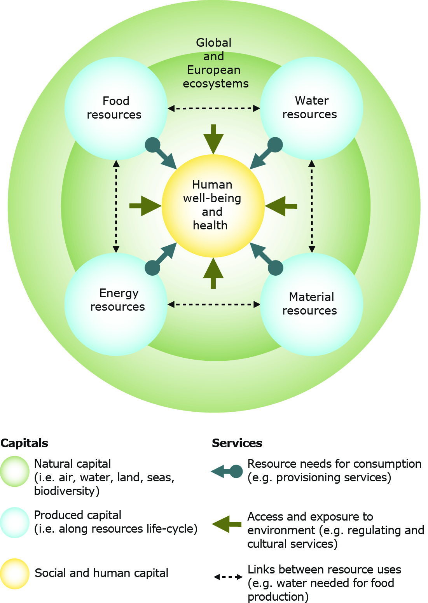
Research Findings
Environmental topics
URL: https://www.eea.europa.eu/themes/environmental-themes
Model and example can be found in this website.
Why use?
I will use this cite to compare the agriculture in Europe and China.
It also gives a general idea of how developed
counties deal with their argriculture problems.

Slide 5
Research Findings
How Mobile Are Resources in Chinese Agriculture?— Implications for China's Agricultural Trade Policy
URL: https://onlinelibrary-wiley-com.ezproxy.library.uvic.ca/doi/abs/10.1111/j.1749-124X.2007.00050.x
This paper studies the mobility of different production resources in China's agriculture, including natural resources, capital investment, human resources and institutional arrangements.
Why use?
It illustrates the resources allocation in China's agriculture.Including the agriculture policies provided after China joined WTO.

Slide 6
Research Findings
China’s South-to-North Water Diversion Project Empowers Sustainable Water Resources System in the North
URL: https://doaj.org/article/9b594492682f432f95e76c47f87355fd
In order to solve the increasingly severe environmental challenges that northern China has been facing for decades due to severe water shortage, the country dicide to divide water form south to north.
Why use?
This paper enhances that the project connectivity among individuals, communities and organizations, makes people aware of the sustainability of goods and services such as energy, irrigation and water supply, and improves people's living standards and living standards.

Slide 7
Relevent Theoretical Tools
Cost Benifit Analysis（CBA）：
This tool will helps me to analyse why the decisions are made by the government of China.
Is every decision made by them in order to improve agriculture worth the output?
What are the intangible benefits and costs?
What are the potential costs and benefits? are these costs and benifits continuous? for how long in approximation?

Slide 8
Relevent Theoretical Tools
Externalities:
This tool will helps me to distinguish whether an activity brings a negative externality or a positive externality to both government and the citizens.
To introduce an activity, if it brings a negative externality to one side of the party, how would we reduce or compensate to the other side. Or if it has a positive externality, how would we reword them?

